Slide 1
Our World

Slide 2
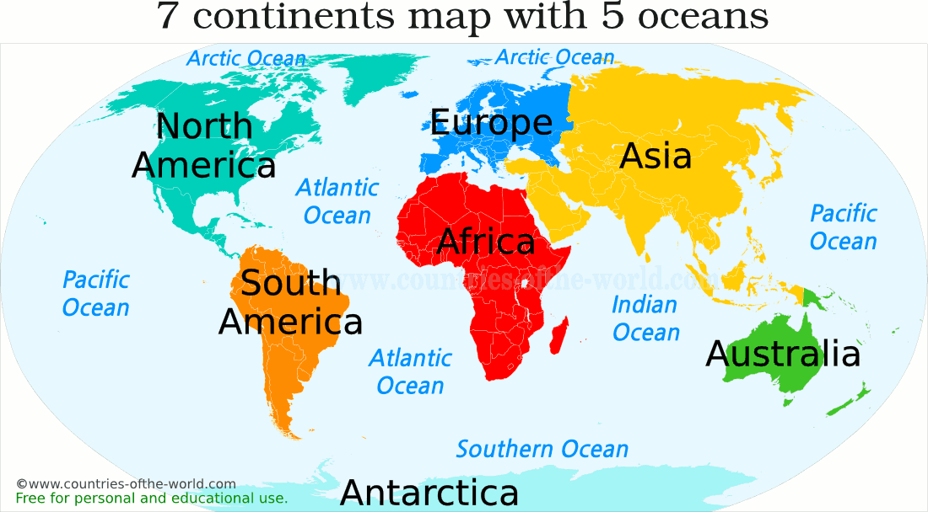
Continents
Continents are large land masses on earth.
There are 7 continents in the world.

Slide 3
Asia
Biggest continent in the world
The largest country in the world – China is located in Asia.
The two most populated countries in the world – India and China are also part of Asia
Asia is surrounded by Europe in the west, the Arctic ocean in the north, the Pacific Ocean in the East and the Indian Ocean in the south.
The world’s ten tallest mountains are found in Asia.
These include the Mount Everest – the highest peak on Earth.

Slide 4
Africa
Africa is the second largest continent in the world.
It is surrounded by the Indian Ocean in the east and Atlantic Ocean in the west.
This continent has the maximum number of countries.
A huge supply of the world’s gold and diamonds comes from Africa.
It has the world’s largest desert – the Sahara Desert.
The world’s longest river is also located in Africa.
Nigeria is the most populated country in Africa.

Slide 5
North America
It is the third biggest continent.
It is surrounded by the Arctic Ocean in the north, the Atlantic Ocean in the east and the Pacific Ocean in the west.
North America has several types of climates.
Canada, Mexico and United States are the three major countries of North America.
Greenland, the largest island in the world, is a part of North America

Slide 6
South America
It is the fourth largest continent.
It is surrounded by the Pacific Ocean in the west and the Atlantic Ocean in the east and North America in the north.
The most important feature of the continent is the Andes mountain chain that runs along its western edge.
Amazon river with the highest water flow is located in South America.
Amazon rainforest in South America are considered to be the lungs of the Earth as they produce nearly 20% of the world’s oxygen.

Slide 7
Antarctica
Antarctica is in the southern most part of the earth.
It encircles the South Pole.
It is surrounded by the Antarctic Ocean.
Antarctica is the only continent with no countries.
No human beings live there as the continent is completely covered with thick layers of ice.
Some scientists stay there temporarily to study more about the continent.
Penguins and seals are some of the animals that can survive here.

Slide 8
Europe
It is the second smallest continent.
It is surrounded by the Arctic Ocean in the north, the Atlantic Ocean in the west.
The Ural mountains form a natural boundary between Europe and Asia.
Europe has all types of landforms except desert.
The Vatican City is the world’s smallest country. It is in Europe.

Slide 9
Australia
It is the smallest continent in the world.
Most of its population lives on the mainland.
It is surrounded by the Indian and Pacific ocean.
It is also known as the ‘Island Continent’.
This is because the continent of Australia includes many islands.
It is the only continent that is named after a country – Australia.
Australia is the world’s sixth largest country in terms of total area.

